Slide 1


Power BI
Software Development Tracking
Monitor sprint progress
bug reports
code commits

Slide 2
What is the purpose of this project? | To track sprint progress, tasks, bugs, and developer contributions in software development.
How is this project useful for Agile teams? | Helps teams monitor progress, identify bottlenecks, and improve efficiency using real-time insights.
What are the key use cases? | Sprint tracking, bug monitoring, developer performance analysis, and task management.
How does this improve decision-making? | Provides data-driven insights to optimize resource allocation, detect delays, and boost productivity.
What are the key features? | Task tracking, bug reports, sprint velocity, developer activity, and interactive filters.

Slide 3
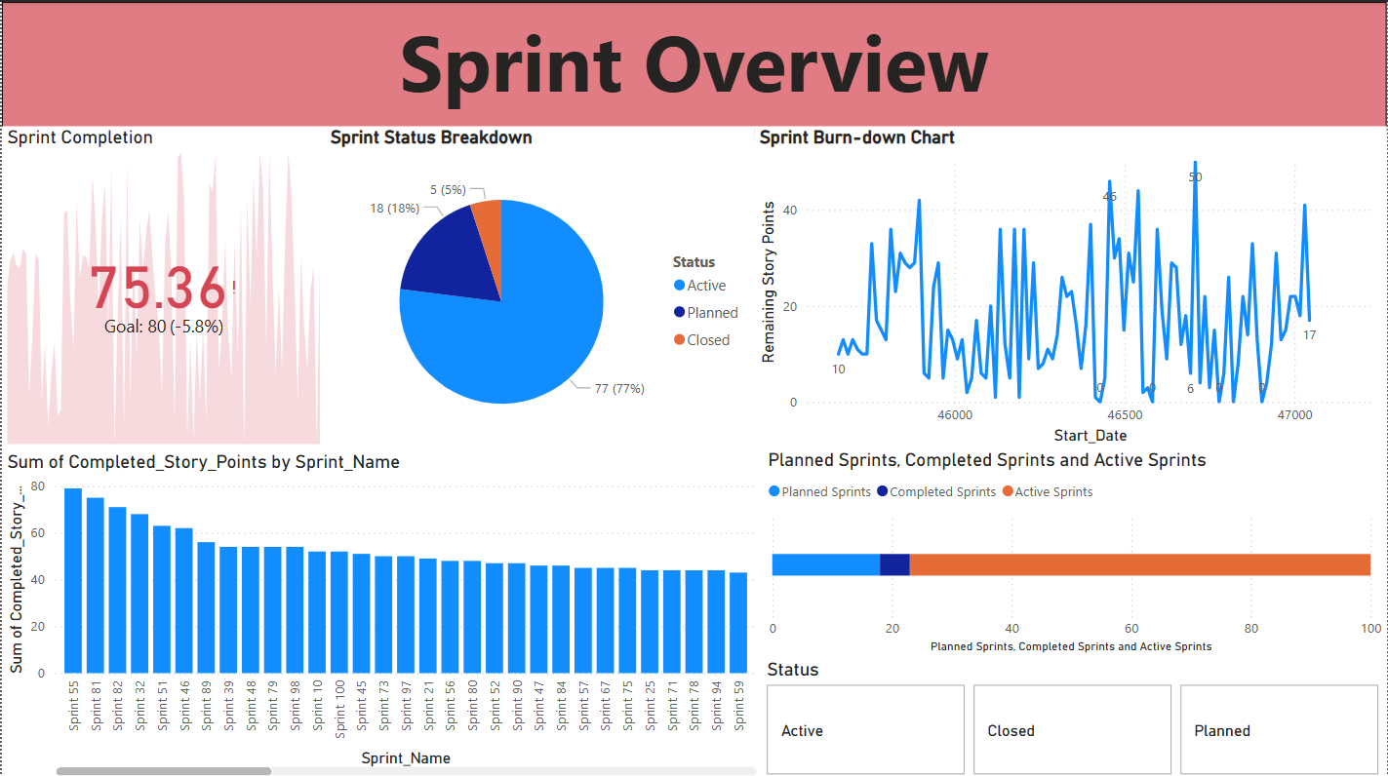
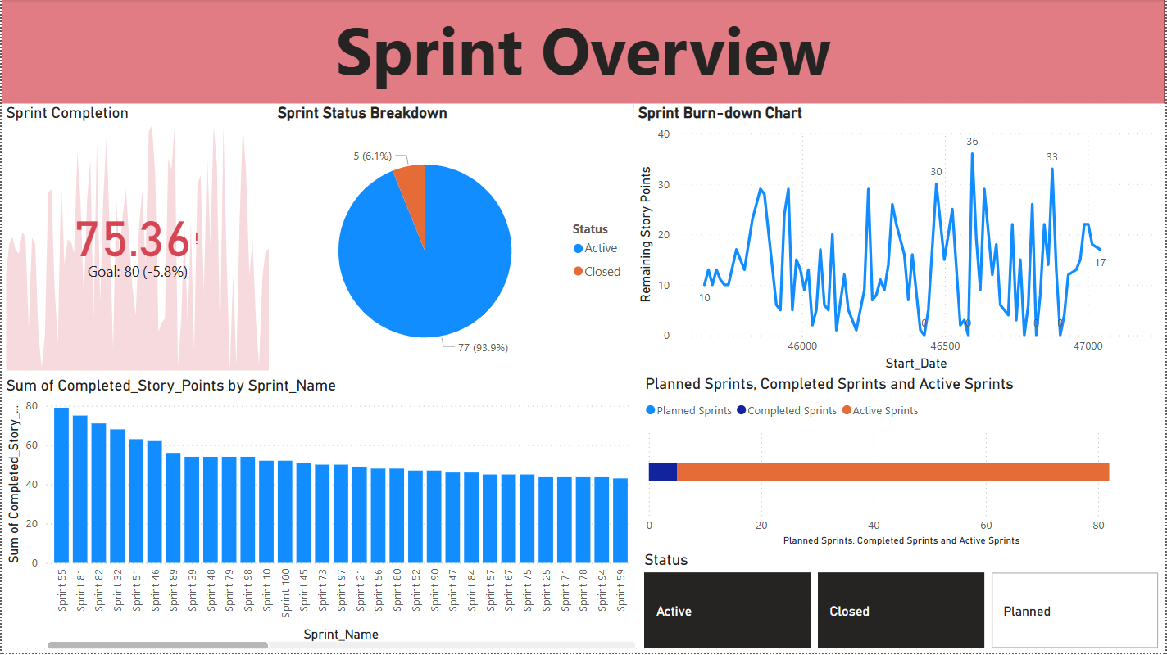

Slide 4
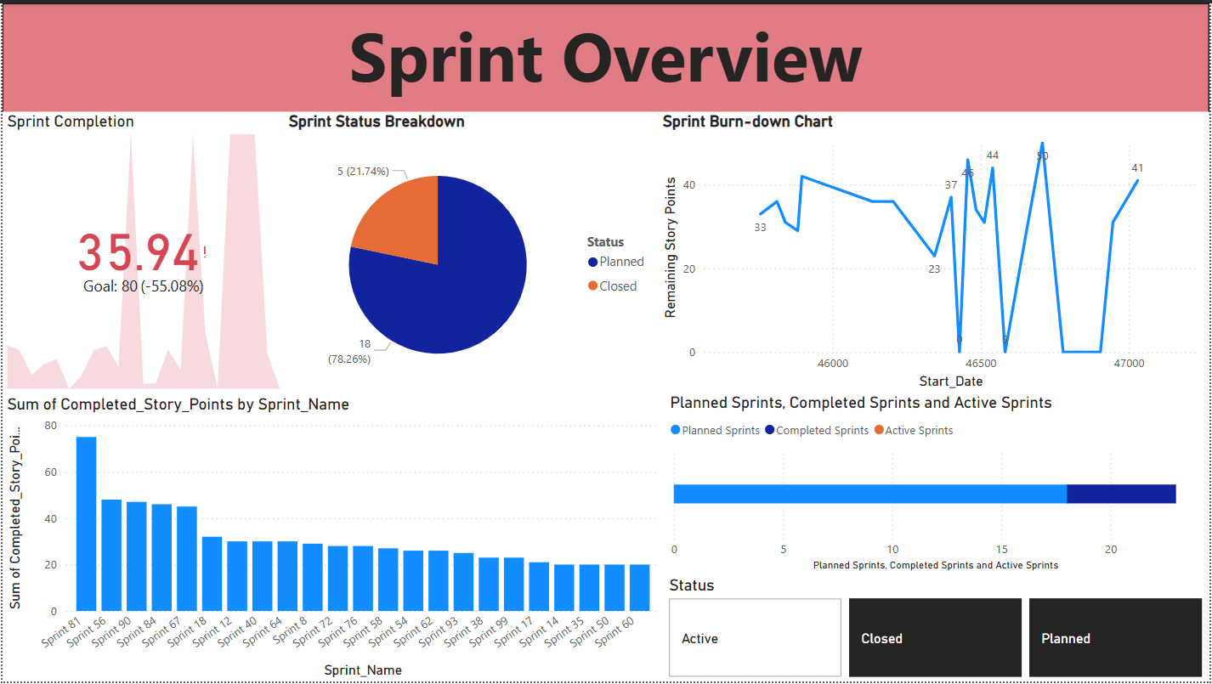

Slide 5
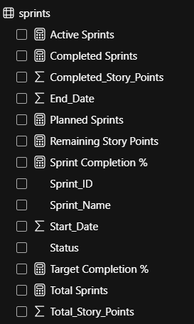
Active Sprints = COUNTROWS(FILTER(sprints, sprints[Status] = "Active"))
Completed Sprints = COUNTROWS(FILTER(sprints, sprints[Status] = "Closed"))
Planned Sprints = COUNTROWS(FILTER(sprints, sprints[Status] = "Planned"))
Remaining Story Points =
SUM(sprints[Total_Story_Points]) - SUM(sprints[Completed_Story_Points])
Sprint Completion % = DIVIDE
(
SUM(sprints[Completed_Story_Points]),
SUM(sprints[Total_Story_Points]),
0
) * 100
Target Completion % = 80
Total Sprints = COUNT(sprints[Sprint_ID])

Slide 6
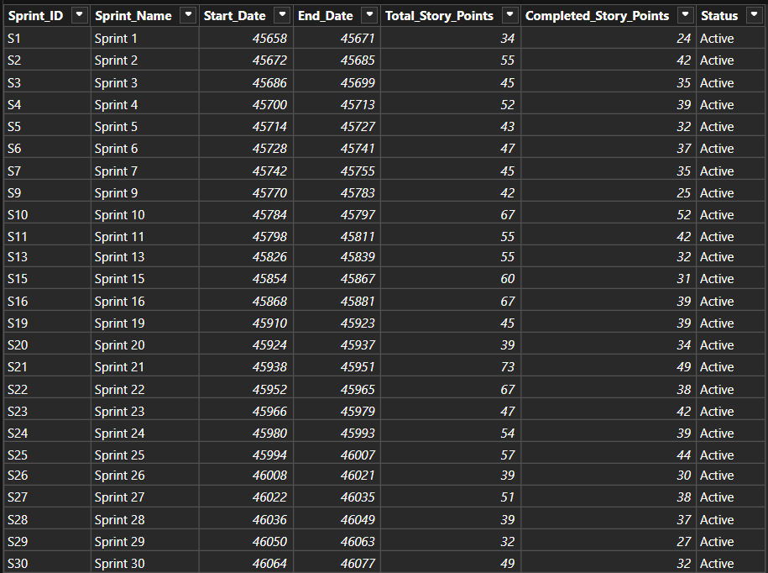
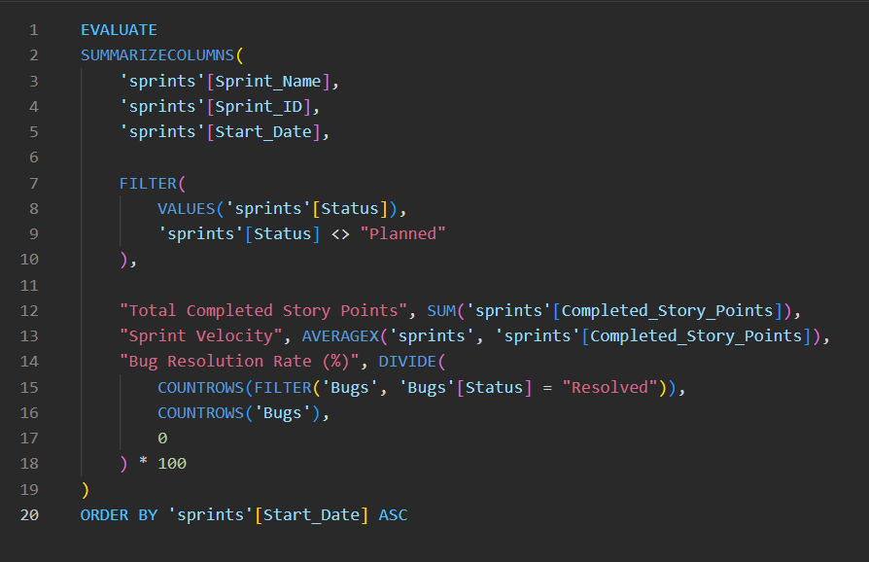
Active Sprints = COUNTROWS(FILTER(sprints, sprints[Status] = "Active"))
Completed Sprints = COUNTROWS(FILTER(sprints, sprints[Status] = "Closed"))
Planned Sprints = COUNTROWS(FILTER(sprints, sprints[Status] = "Planned"))
Remaining Story Points =
SUM(sprints[Total_Story_Points]) - SUM(sprints[Completed_Story_Points])
Sprint Completion % = DIVIDE
(
SUM(sprints[Completed_Story_Points]),
SUM(sprints[Total_Story_Points]),
0
) * 100
Target Completion % = 80
Total Sprints = COUNT(sprints[Sprint_ID])

Slide 7
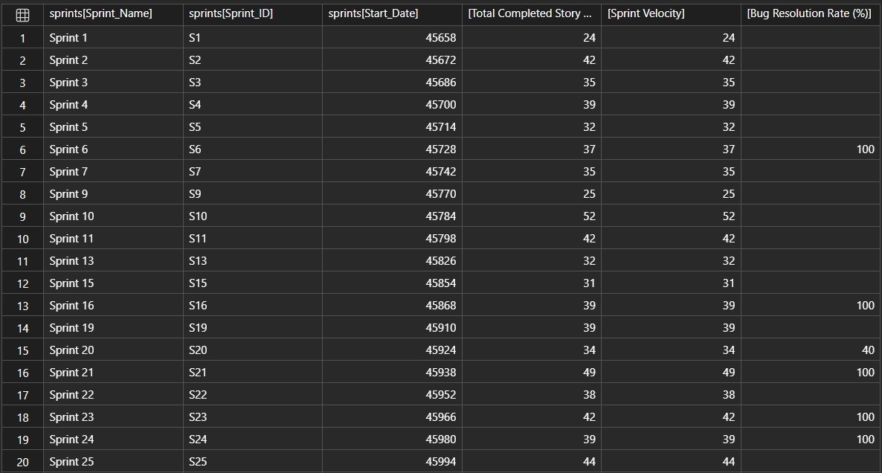
Active Sprints = COUNTROWS(FILTER(sprints, sprints[Status] = "Active"))
Completed Sprints = COUNTROWS(FILTER(sprints, sprints[Status] = "Closed"))
Planned Sprints = COUNTROWS(FILTER(sprints, sprints[Status] = "Planned"))
Remaining Story Points =
SUM(sprints[Total_Story_Points]) - SUM(sprints[Completed_Story_Points])
Sprint Completion % = DIVIDE
(
SUM(sprints[Completed_Story_Points]),
SUM(sprints[Total_Story_Points]),
0
) * 100
Target Completion % = 80
Total Sprints = COUNT(sprints[Sprint_ID])

Slide 9
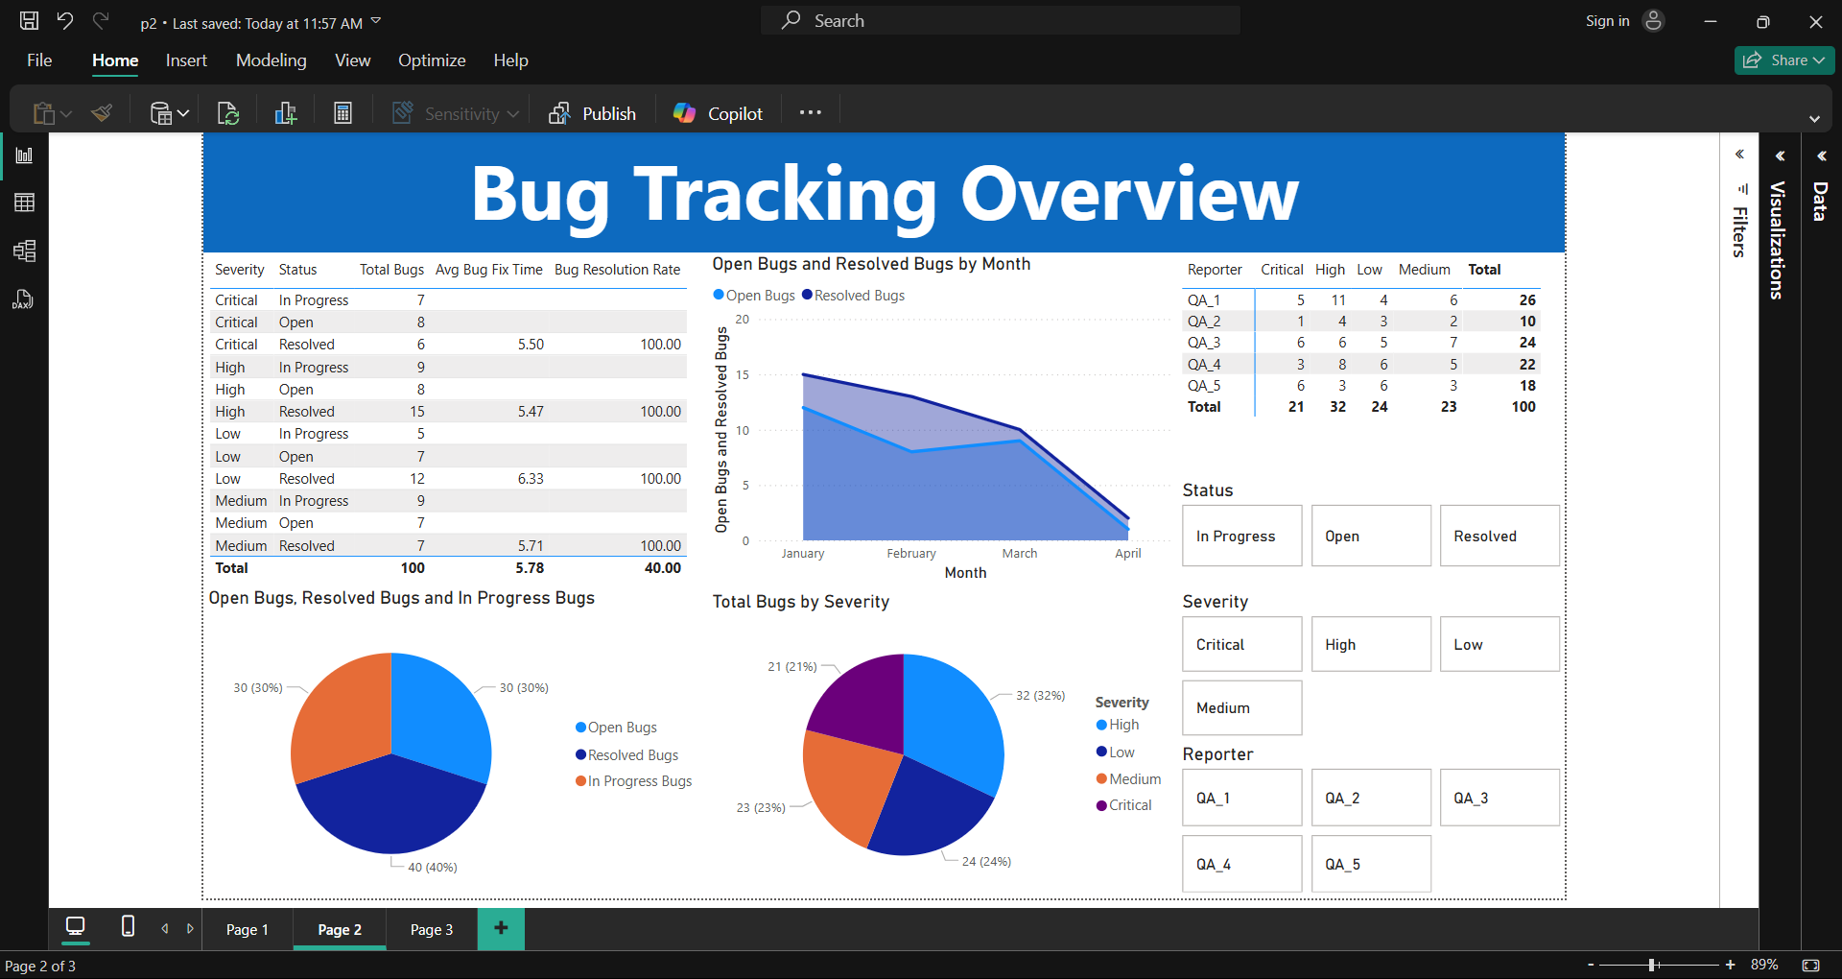

Slide 10
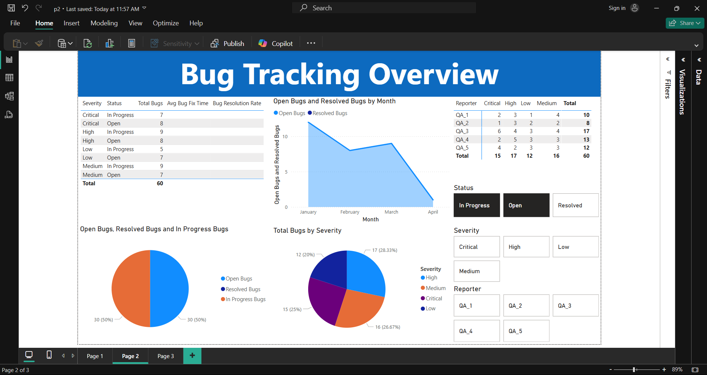

Slide 11
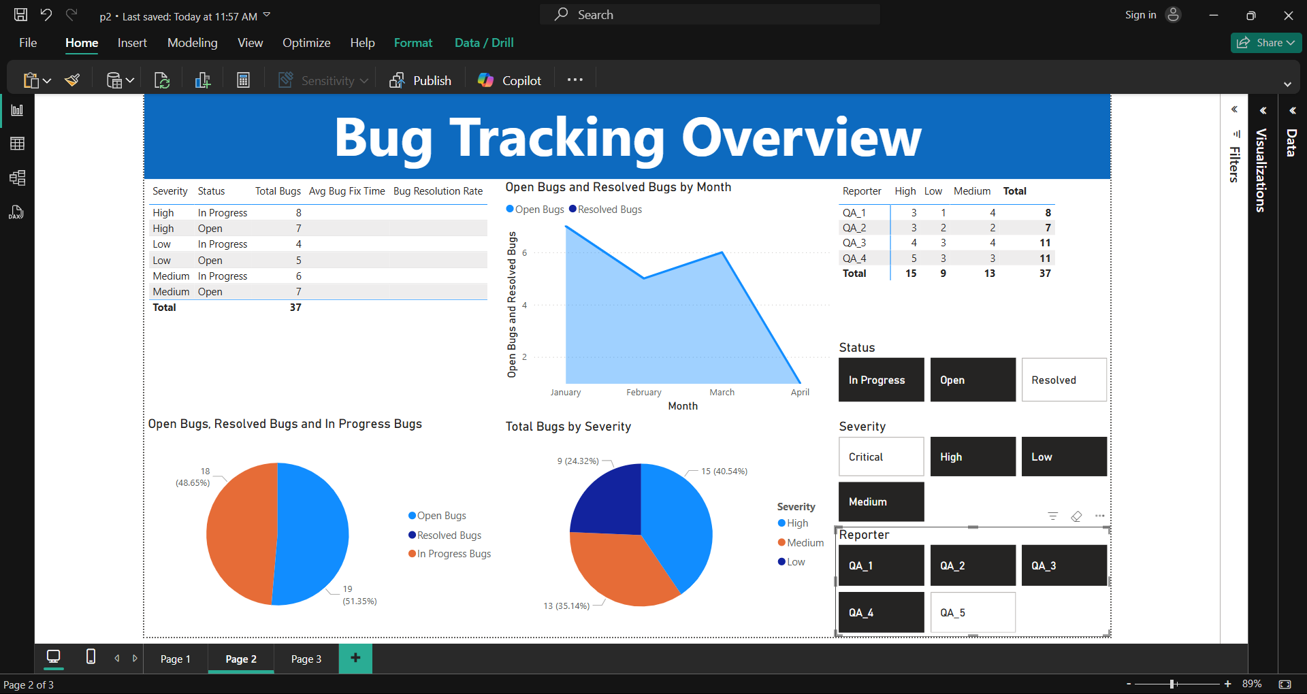

Slide 12
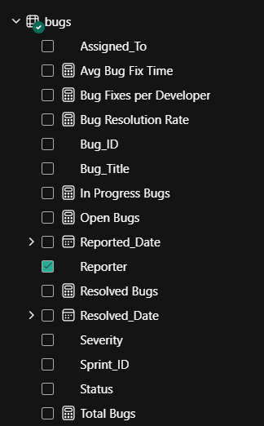
Avg Bug Fix Time =
AVERAGEX(
FILTER(bugs, bugs[Status] = "Resolved"),
DATEDIFF(bugs[Reported_Date], bugs[Resolved_Date], DAY)
)
Bug Fixes per Developer =
CALCULATE(
COUNTROWS(bugs),
FILTER(bugs, bugs[Status] = "Resolved")
)
Bug Resolution Rate =
DIVIDE(
COUNTROWS(FILTER(bugs, bugs[Status] = "Resolved")),
COUNTROWS(bugs),
0
) * 100
In Progress Bugs = COUNTROWS(FILTER(bugs, bugs[Status] = "In Progress"))
Open Bugs = COUNTROWS(FILTER(bugs, bugs[Status] = "Open"))
Resolved Bugs = COUNTROWS(FILTER(bugs, bugs[Status] = "Resolved"))
Total Bugs = COUNTROWS(bugs)

Slide 13
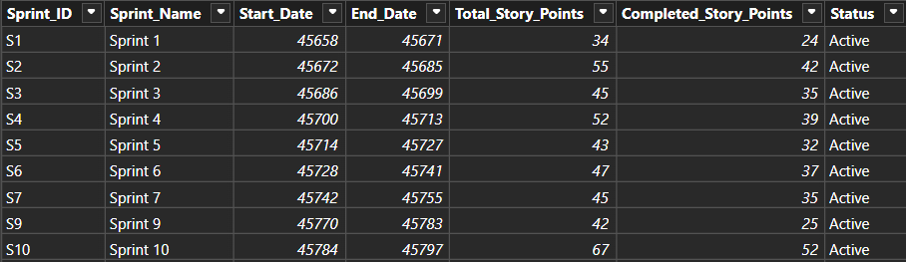
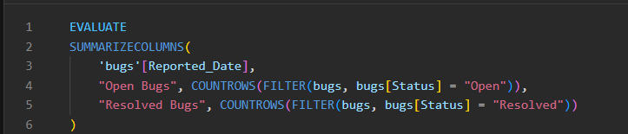
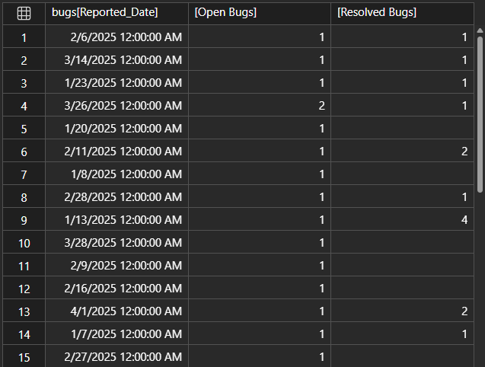
Avg Bug Fix Time =
AVERAGEX(
FILTER(bugs, bugs[Status] = "Resolved"),
DATEDIFF(bugs[Reported_Date], bugs[Resolved_Date], DAY)
)
Bug Fixes per Developer =
CALCULATE(
COUNTROWS(bugs),
FILTER(bugs, bugs[Status] = "Resolved")
)
Bug Resolution Rate =
DIVIDE(
COUNTROWS(FILTER(bugs, bugs[Status] = "Resolved")),
COUNTROWS(bugs),
0
) * 100
In Progress Bugs = COUNTROWS(FILTER(bugs, bugs[Status] = "In Progress"))
Open Bugs = COUNTROWS(FILTER(bugs, bugs[Status] = "Open"))
Resolved Bugs = COUNTROWS(FILTER(bugs, bugs[Status] = "Resolved"))
Total Bugs = COUNTROWS(bugs)

Slide 14
Thank
You
Power BI Project 2 – Software Development Tracking

